Slide 1



05.B Editing Files
create and edit text files from the command line using the vim editor

Slide 2
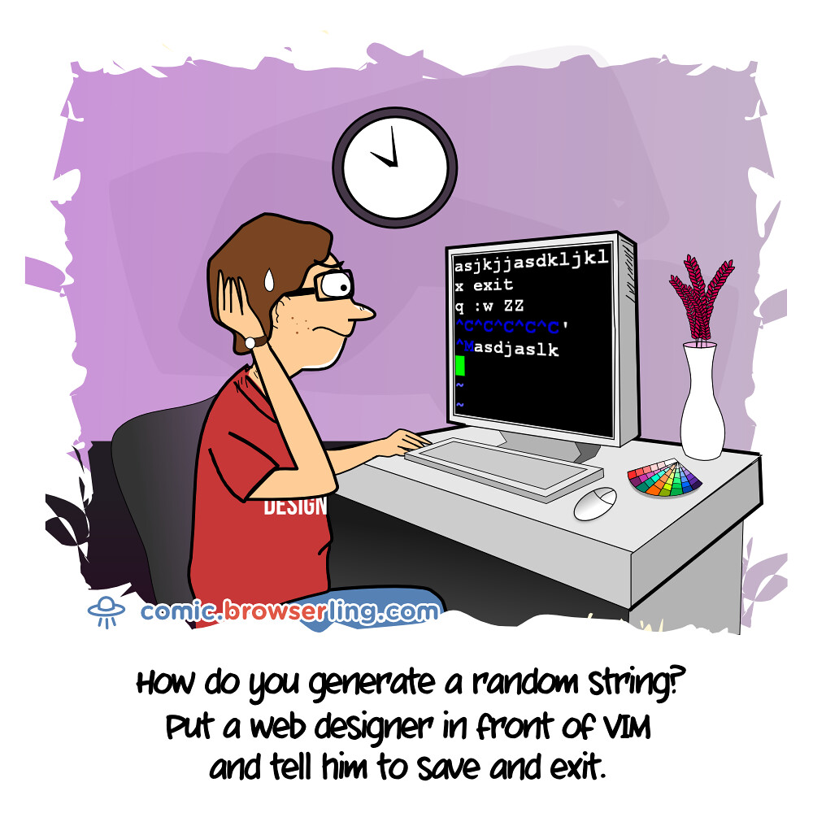

This Photo by Unknown Author is licensed under CC BY-NC

Slide 3


EDITING FILES WITH VIM
Vim is an improved version of the vi editor distributed with Linux and UNIX systems

Slide 4

Why
Why Learn Vim?
You should know how to use at least one text editor that can be used from a text-only shell prompt.
If you do, you can edit text-based configuration files from a terminal window, or from remote logins
through ssh or the Web Console.

Slide 5

Why
Why Vim?
almost
always installed on a server, if any text editor is present. This is because vi was specified by the
POSIX standard that Linux and many other UNIX-like operating systems comply with in large part
This Photo by Unknown Author is licensed under CC BY-NC-ND

Slide 6

Starting Vim
Minimal install
[user@host ~]$ vi FileName
Normal install
[user@host ~]$ vim FileName

Slide 7
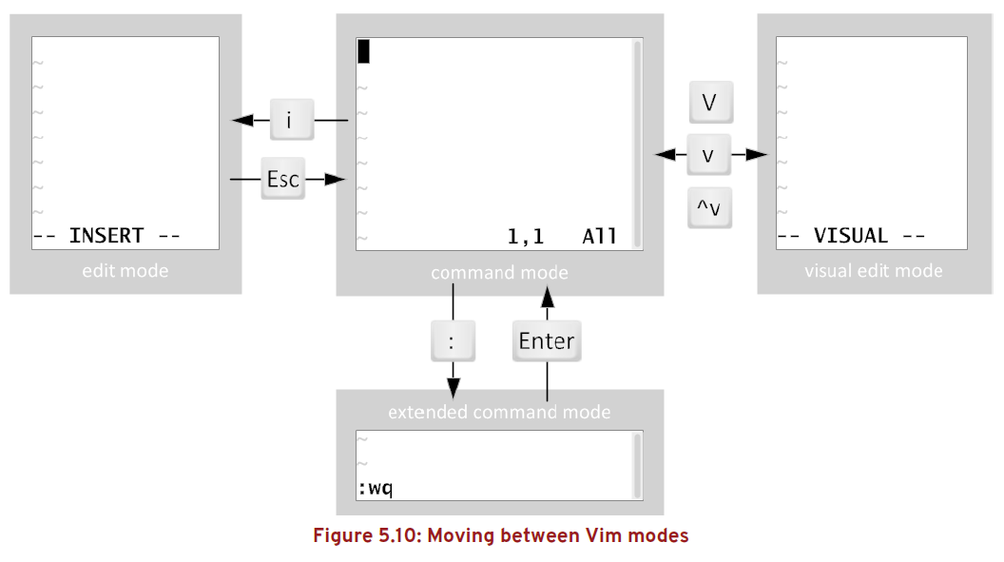
Vim operating modes

Slide 8
command mode
used for navigation, cut and paste,
and other text manipulation

Slide 9
insert mode
An i keystroke enters insert mode, where all text typed becomes file content. Pressing Esc
returns to command mode.

Slide 10
visual mode
A v keystroke enters visual mode, where multiple characters may be selected for text
manipulation. Use Shift+V for multiline and Ctrl+V for block selection. The same keystroke
used to enter visual mode (v, Shift+V or Ctrl+V) is used to exit.

Slide 11
visual mode
• Character mode: v
• Line mode: Shift+V
• Block mode: Ctrl+V

Slide 12
Exit & saving
The :w command writes (saves) the file and remains in command mode for more editing. The :wq command writes (saves)
the file and quits Vim. The :q! command quits Vim, discarding all file changes since the last write.

Slide 13
yank and put
copy and paste is known as yank and put, using command characters Y and P.

Slide 14
vimtutor

